Slide 1

Amazon Business Review
Project
Sales Performance & Analytics
Q4-2019
Presented By
Prathap David Carlo

Slide 2

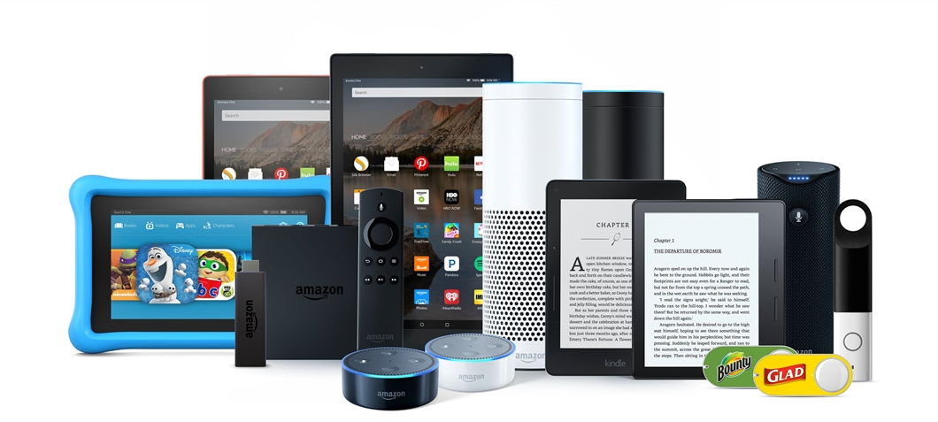
Project Overview and Dataset
Period - 2019-Q4 ( October 1 to December 31st)
Division - Electronics Products
Business Area – USA
Market - E-Commerce/Online
Dataset: Kaggle
https://www.kaggle.com/datasets/knightbearr/sales-product-data
No of Data Sets : 3
File Format: CSV
Total Rows from 3 datasets: 62.8K
Total Columns: 6

Slide 3

Tools and Methodology
Data Cleaning and Transformation - MS SQL SERVER
Missing Data Found
Data was inconsistent
Duplicated Column headers
Data Pipelines & Modeling - Power BI Query Editor & Power Pivot
Imported Date Drill Down query
Imported State Names from Wikipedia
Normalized the Data Model and established the relationships (Dax)
Data Visualization and Publishing - Power BI Desktop and Services
Created Reports - Mobile View Set up - Published
Created Workspace - uploaded required Pbix files
Created App - set up – Access Management
CSV files
MS SQL SEVER
Power Query Editor & Power Pivot
DAX Queries
Demographic factors
1. Age
2. Household income
3. Profession
Target Audience Visitation Venues
1. Eaton Centre
2. Fairview Mall
3. Yonge and Dundas
4. Union Station
Create Visualizations Power BI Desktop
Publish Reports and App

Slide 4
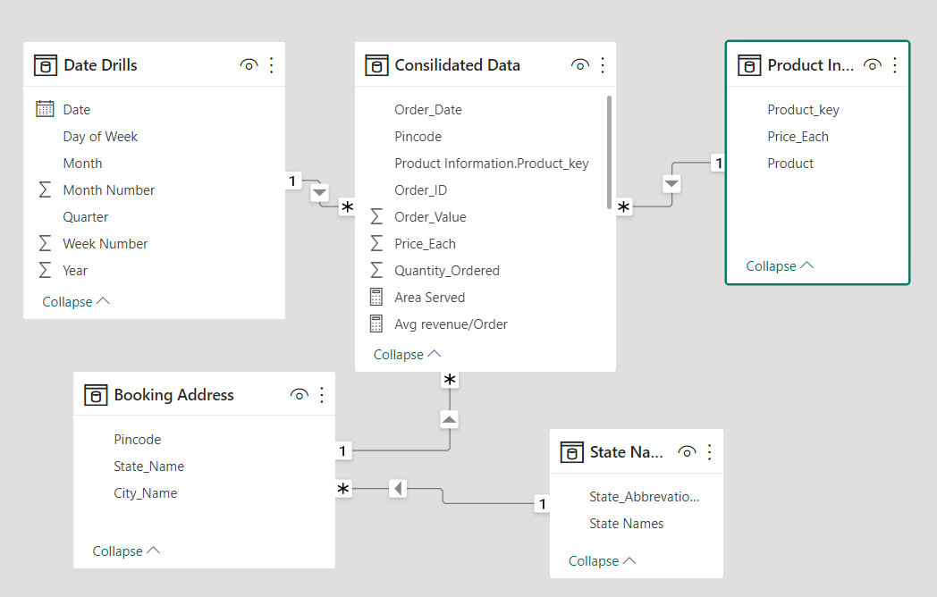
Data Model
19 products
9 states
State Names from Wiki

Slide 5
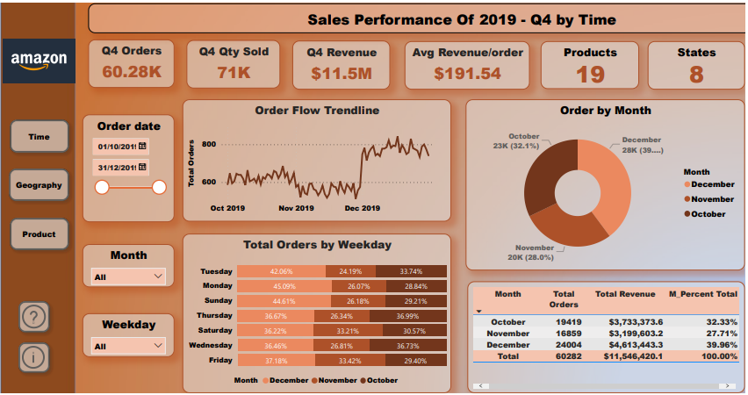

Slide 6
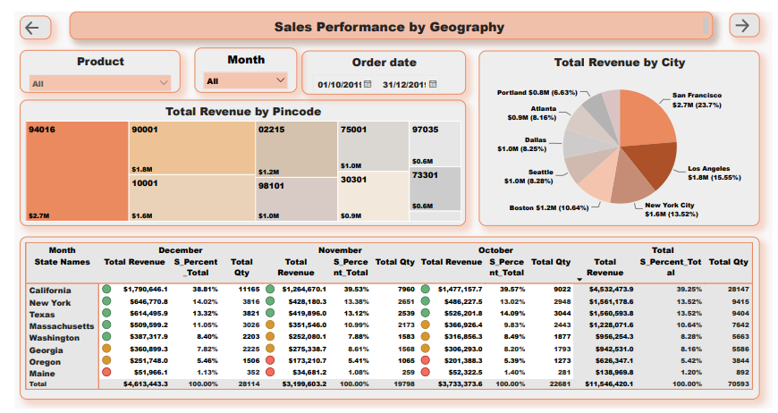

Slide 7
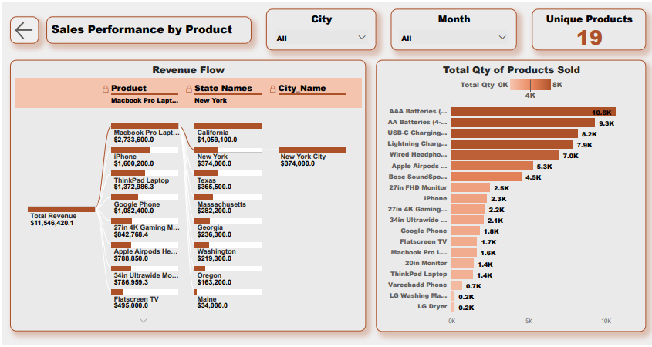

Slide 8
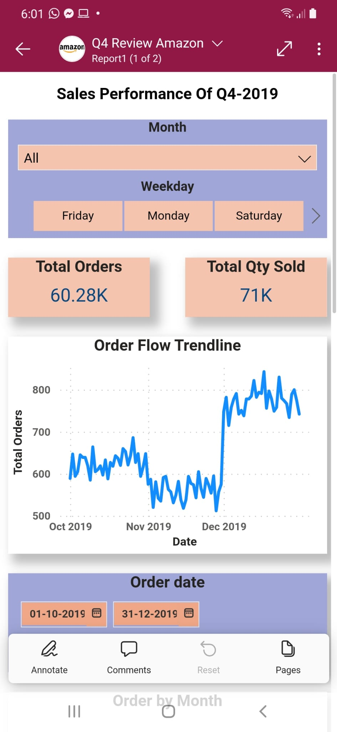
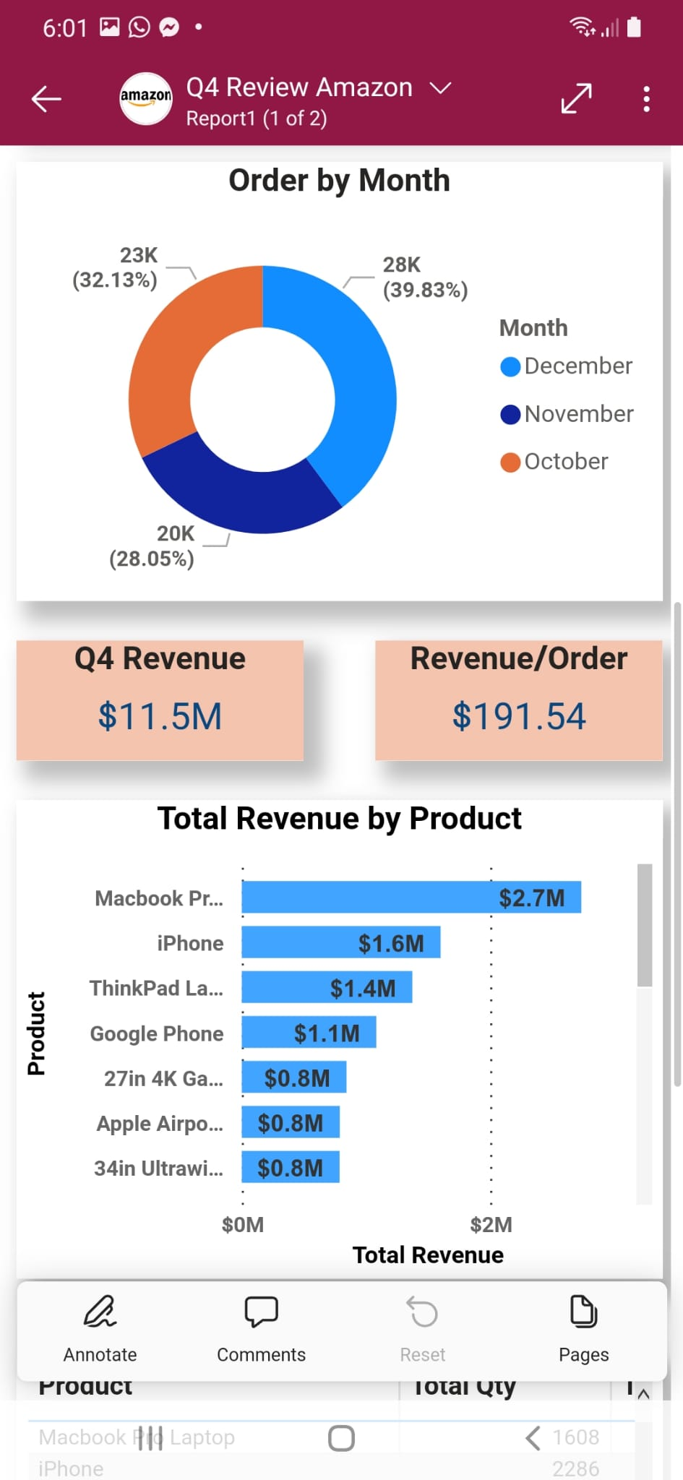
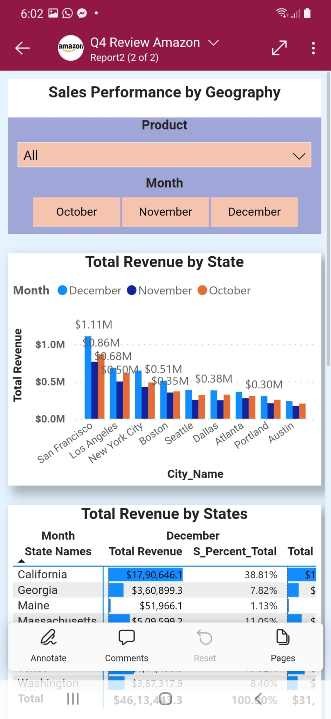
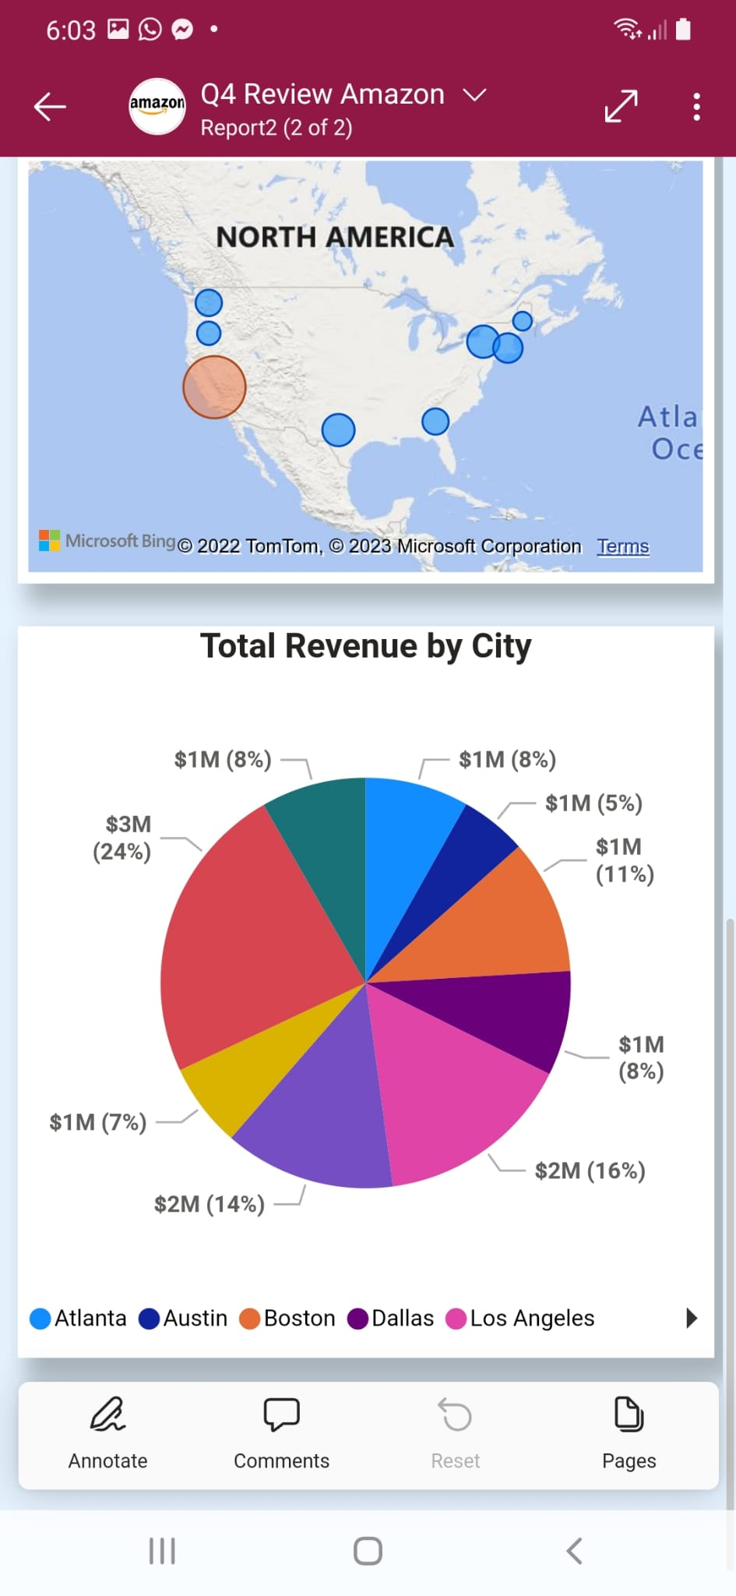
Power BI App View
Demographic factors
1. Age
2. Household income
3. Profession
Target Audience Visitation Venues
1. Eaton Centre
2. Fairview Mall
3. Yonge and Dundas
4. Union Station

Slide 9
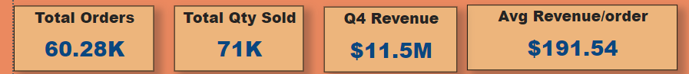
Key Insights
Sales by Time
40% in December, 32% in October, and 27% in November - 5% Decline, 13% increase
All weekdays have similar contributions - orders are placed irrespective of weekdays or weekends
Observed a Positive Trend for revenue from October to December
Sales by Product
Macbook Pro Laptop was the highest Contributor to Revenue - $2.7M ( 23.67%)
AAA batteries were the lowest revenue Contributor – $0.03M (0.28% )
Highest qty sold was AAA batteries -10000+ units
Lowest Qty sold was LG Dryer – 192 units
Sales by Territory
California was ranked first out of 8 states – $4.5M ( 40%)
Maine State - Least -$0.1 M (1.20%)
San Francisco City - Highest -$2.7M(23.7%)
Austin City - Lowest -$0.6M(5.27%)

Slide 10


